Slide 1
Overview of Computer Networks
Protocols and the TCP/IP Protocol Suite
Mi-Jung Choi
mjchoi@kangwon.ac.kr
Dept. of Computer Science and Engineering
Kangwon National University
Fall 2020

Slide 2
Referenced Book
Stallings, W., Computer Networks with Internet Technology, Prentice Hall, Upper Saddle River NJ. Chapter 2

Slide 3
Contents
Three key elements of a PROTOCOL
A Simple Protocol Architecture
OSI reference model
The TCP/IP protocol architecture

Slide 4
Key Elements of a Protocol
Syntax
  Data formats
  Signal levels
Semantics
  Control information
  Error handling
Timing
  Speed matching
  Sequencing
Notes:
When you are design a protocol, you have to consider these elements

Slide 5
Protocol Architecture
Task of communication broken up into modules
For example file transfer could use three modules
  File transfer application
  Communication service module
  Network access module

Slide 6
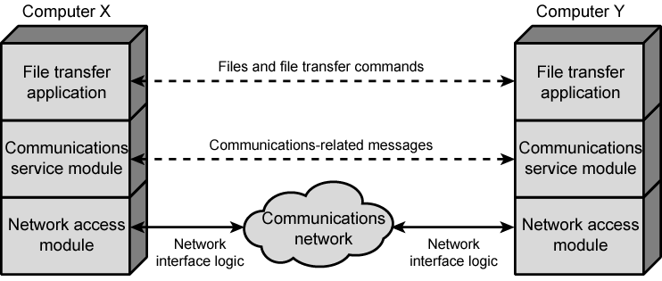
Simplified Architecture for File Transfer

Slide 7
A Three Layer Model
Network Access Layer
Transport Layer
Application Layer

Slide 8
Network Access Layer
Exchange of data between the computer and the network
Sending computer provides address of destination
Dependent on type of network used (LAN, packet switched etc.)
Notes:
LLC: logical link control

Slide 9
Transport Layer
Reliable data exchange
Independent of network being used
Independent of application

Slide 10
Application Layer
Support for different user applications
e.g. e-mail, file transfer

Slide 11
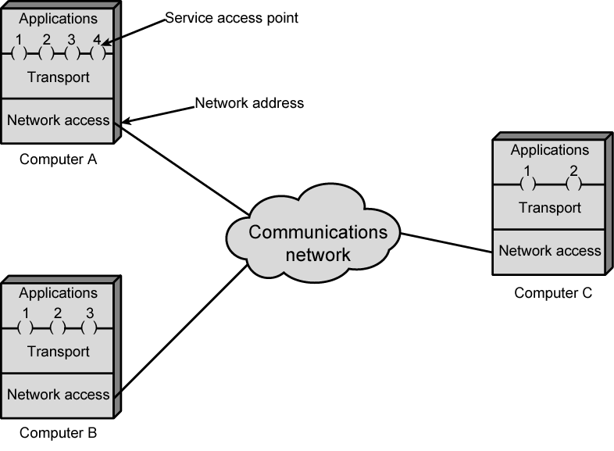
Protocol Architectures and Networks

Slide 12
Addressing Requirements
Two levels of addressing required
Each computer needs unique network address
  The network address
  The IP address on TCP/IP stacks
Each application on a (multi-tasking) computer needs a unique address within the computer
  The service access point or SAP
  The port on TCP/IP stacks

Slide 13
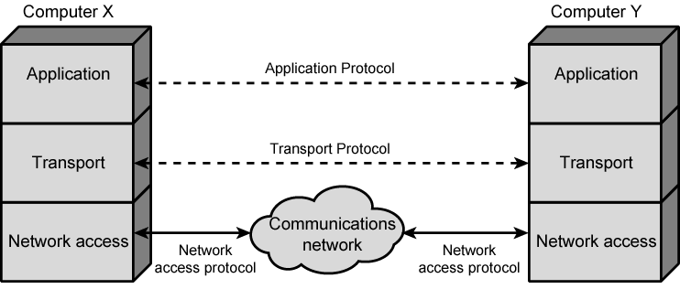
Protocols in Simplified Architecture

Slide 14
Protocol Data Units (PDU)
At each layer, protocols are used to communicate
Control information is added to user data at each layer
  Application Header + User Data
  Application PDU
Transport layer may fragment user data
Each fragment has a transport header added
  Destination SAP
  Sequence number
  Error detection code
This gives a transport protocol data unit
  Transport PDU

Slide 15
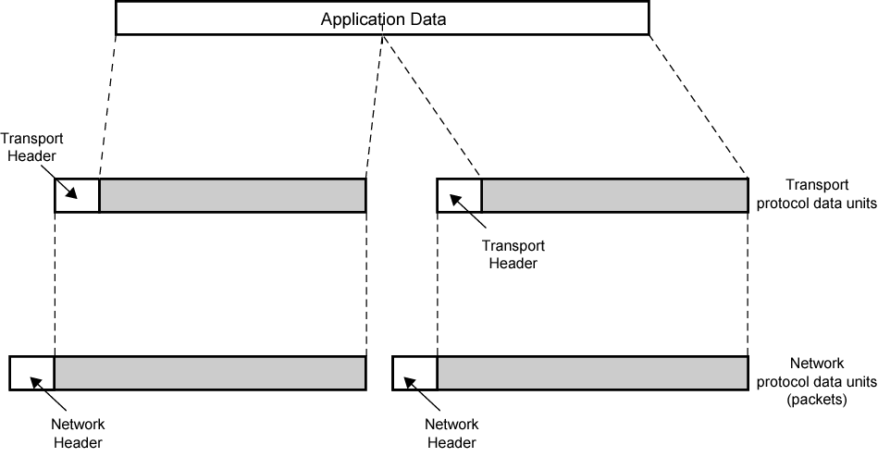
Protocol Data Units

Slide 16
Network PDU
Adds network header
  network address for destination computer
  Facilities requests: priority, route

Slide 17
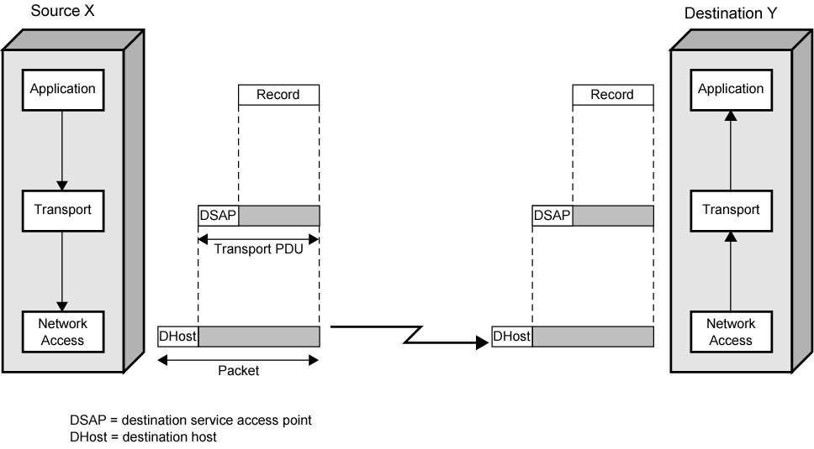
Operation of a Protocol Architecture

Slide 18
Standardized Protocol Architectures
OSI vs. TCP/IP
Required for devices to communicate
Vendors have more marketable products
Customers can insist on standards based equipment
Two standards:
  OSI Reference model
    Never lived up to early promises
  TCP/IP protocol suite
    Most widely used

Slide 19


Q & A
Q & A 게시판
Transport Layer
3-<number>

